Slide 1
INDIAN AGRICULTURE ANALYSIS USING POWER BI
By Himanshi Sahu

Slide 2
Problem Statement:
This internship project aims to conduct a comprehensive analysis of Indian agriculture, focusing on
district-wise and year-wise data. The dataset provides detailed information on various crops, their areas,
production, and yields across different districts and years. The goal is to leverage Power BI to create
interactive visualizations that uncover trends, patterns, and disparities in agricultural practices, enabling
stakeholders to make informed decisions for sustainable farming and resource allocation.
Dataset Description:
The dataset encompasses a wide range of agricultural variables, including crop areas, production
quantities, and yields for different crops such as rice, wheat, sorghum, millets, pulses, oilseeds, sugarcane,
and more.

Slide 3
Deliverables:
Interactive Power BI dashboards providing insights into year-wise and district-wise agricultural patterns.
Visualizations depicting trends in major crops and their variations over time.
Reports on regional disparities, seasonal patterns, and the impact of external factors.
Recommendations for policymakers and stakeholders in the
agriculture sector.

Slide 4
INTRODUCTION
Agriculture plays a crucial role in India's economy, contributing significantly to employment, livelihoods, and food security. However, the sector faces various challenges, including climate change, land degradation, and resource constraints. Over this project, we deal with delved into district-wise and year-wise agricultural data, exploring a wide range of variables such as crop areas, production quantities, and yields. Our goal has been to uncover trends, patterns, and disparities in agricultural practices, with the ultimate aim of providing valuable insights to stakeholders in the agriculture sector .
Through the use of Power BI, we have created interactive visualizations that not only showcase the current state of Indian agriculture but also provide actionable insights for policymakers, researchers, and practitioners we will take you through our journey of data exploration, crop-specific analysis, identification of regional disparities, exploration of seasonal patterns, investigation of external factors' impact, analysis of fruits and vegetables cultivation trends, and derivation of sustainable farming

Slide 5
Project Objectives:
Data Exploration: Explore the dataset to understand the distribution of agricultural variables across districts and years.
Crop-specific Analysis: Analyze trends in the cultivation of major crops, focusing on changes in area, production, and yield.
Regional Disparities: Identify disparities and variations in agricultural practices and outcomes across different districts and states.
Seasonal Patterns: Explore seasonal patterns in crop cultivation, considering kharif and rabi seasons.
Impact of External Factors: Investigate the impact of external factors like weather conditions on crop performance.

Slide 6
Fruits and Vegetables Analysis:
Analyze the cultivation trends of fruits, vegetables, and their overall contribution to agricultural practices.
Sustainable Farming Insights:
Derive insights that can contribute to promoting sustainable farming practices and optimizing resource allocation.

Slide 7
Data Exploration Objective:
Explore the dataset to understand the distribution of agricultural variables across districts and years.
Key Points:Dataset Overview: Begin by providing an overview of the dataset, including the number of records, columns, and the time range covered.
Exploratory Visualizations: Showcase visualizations such as histograms, box plots, and heatmaps to analyze the distribution of agricultural variables across districts and years.
Insights Gained: Summarize the insights gained from the data exploration phase, highlighting any notable trends or patterns observed in the data.

Slide 8
Crop-specific Analysis Objective:
Our next objective was to conduct a detailed analysis of major crops, including rice, wheat, and pulses, focusing on changes in cultivation area, production quantities, and yields over time.
Key Points:Major Crops Examined:We focused our analysis on key crops that play a significant role in Indian agriculture, namely rice, wheat, and pulses.These crops were selected based on their importance in terms of production, consumption, and economic value.
Trends in Cultivation Area: We analyzed the changes in cultivation area for each crop over the years, aiming to identify any shifts or trends in agricultural practices . Visualizations such as line charts were utilized to depict the trend in cultivation area for each crop, allowing us to observe any fluctuations or patterns.

Slide 9
Regional Disparities Objective:
Our analysis also aimed to identify disparities and variations in agricultural practices and outcomes across different districts and states in India.
Key Points:Geographical Variations:India is characterized by diverse geographical and climatic conditions, resulting in significant variations in agricultural practices and outcomes across different regions.Our analysis sought to identify and understand these variations to provide insights into regional disparities in agriculture.
District-wise Analysis:We conducted a district-wise analysis to compare agricultural variables such as crop cultivation area, production quantities, and yields across different districts.Visualizations such as maps and heatmaps were utilized to illustrate the geographical distribution of agricultural practices and outcomes.

Slide 10
State-level Comparison:In addition to district-wise analysis, we compared agricultural practices and outcomes at the state level to identify broader patterns and trends.State-level comparisons allowed us to assess the overall performance of agricultural sectors in different states and regions.
Identification of Disparities:By analyzing the data, we were able to identify disparities and variations in agricultural practices and outcomes across regions.These disparities may be influenced by factors such as geographical features, climate conditions, agricultural policies, and socio-economic factors.

Slide 11
Conclusion:
Summarize the key findings and insights derived from the analysis, highlighting significant trends, patterns, and disparities observed in Indian agriculture.Emphasize the importance of data-driven decision-making in addressing the challenges faced by the agriculture sector.
Impact:Reflect on the potential impact of our analysis and recommendations on the agriculture sector in India.Discuss how the insights provided can contribute to promoting sustainable farming practices, improving productivity, and ensuring food security.
Future Directions:Suggest potential areas for further research or analysis to build upon the findings of this project.Highlight opportunities for future projects aimed at addressing emerging challenges and opportunities in Indian agriculture.

Slide 12
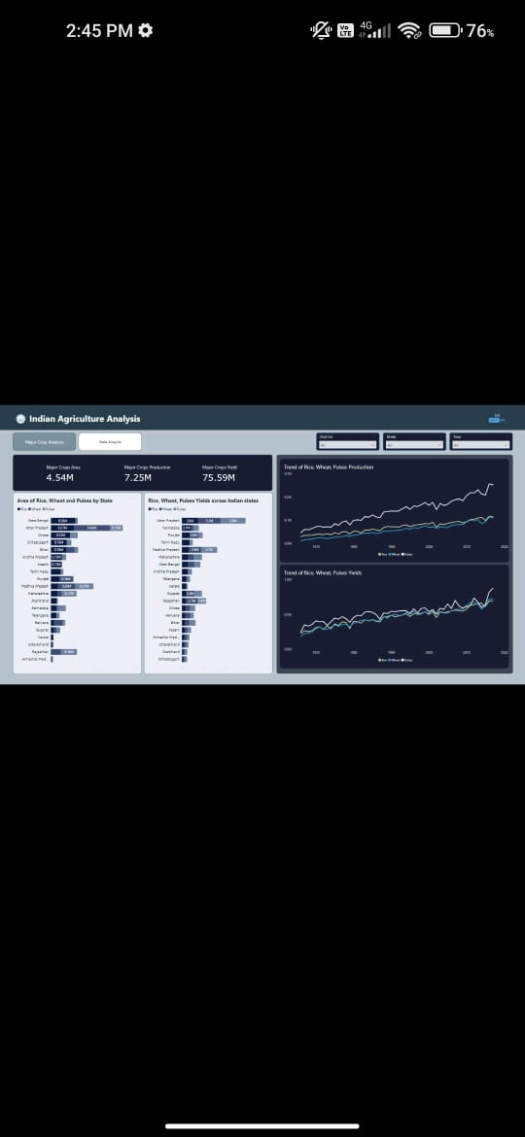

Slide 13
THANK YOU

